Slide 1

DATA 515A
Software Engineering for Data Scientists Package Structure
David Beck^{1,2}, Joseph Hellerstein^{1,3}, Bernease Herman¹
Colin Lockhard³
¹eScience Institute
²Chemical Engineering
³Computer Science Engineering
The University of Washington
Oct 9, 2018

Slide 2
Overview
Virtual environments
What is a Python package with examples
What is continuous integration?
In class work & homework

Slide 3
Virtual Environments
What is virtualization?
Why do I want virtualization?
What types of virtualization are available?
virtualenv – Python environment ‘virtualization’
Subsystems - e.g. Windows 10 Ubuntu
Virtual machines
Virtual Box
EC2
Docker

Slide 4
What is virtualization?
Fancy word alert!
Virtualization is the ‘abstraction’ of an environment, process, operating system, or hardware
Abstraction means to remove direct connections with the underlying infrastruction
The most common type of virtualization is hardware, e.g. With Virtual Box

Slide 5
What do I want virtualization?
Reproducibility
Pre-packaged software ‘appliances’
Ease of redistrubality
Solves the problem of dependency hell!
What is dependency hell you ask?

Slide 6
Why is this happening?
Software not available or other software issue
Dependency hell
Dependency chains (A depends on B depends on C …)
Conflicting dependencies
Circular dependencies (A depends on B depends on A)

Slide 7
What types of virtualization are available?
Thought experiment time:
Which is going to be the fastest?
Virtual environments
Allow you to create parallel and independent software environments for tools like Python and R
Virtual machines
Create totally indendent ‘virtual’ computers that run their own ‘guest’ operating systems on a ‘host’
Virtual operating systems
’Guest’ OS share the ’host’ kernel and process space but have their own discrete ‘filesystems’

Slide 8
virtualenv
Virtual environments for python
Only ’abstracts’ the python environment
If you use conda (and you should) you can do this for R!
Allows you to setup a python environment speicifc to a project
Why?
Python 2.7 vs. 3.5
Need to keep outdated package X becuase it is the last that is compatible with package Y, another project needs updated X
Replicate the minimal python environment to give to users or travis CI

Slide 9
virtualenv
Virtual environments with conda
conda create –n <name> <options>
Where options are things like what python version to use
https://conda.io/docs/using/envs.html
After creating, switch to it with ‘source activate <name>’
Do a `which python`
Switch out with ‘source deactivate <name>’
Use conda or pip to install packages
Export environment: `conda env export > environment.yml`
Create an environment from an exported env:
`conda env create -f environment.yml`
List environments: `conda env list`
Play time! Everyone create a python 2.7 environment with jupyter and pandas. Start a notebook and prove to yourself it is 2.7.

Slide 10
requirements.txt
Python requirements.txt files
Similar to conda’s environment.yml, but only have pip installed components
The pip tool can be used to generate these:
pip freeze > requirements.txt
You can feed this to travis CI or use it to repopulate an environment, e.g.
pip install –r requirements.txt
Play time! Each team create and gitify your requirements.txt. Where does it go in your repo?

Slide 11
Subsystems
Some of the oldest types of ‘multi-universe’ computing
The host emulates enough of the guest kernel to run in host user space
E.g. Windows 10 Subsystem for Linux

Slide 12
Subsystems
Example...
Linux subsystem for Windows 10 runs Ubuntu
https://msdn.microsoft.com/en-us/commandline/wsl/install_guide
Don’t need gitbash
Can integrate Windows native apps with Ubuntu
Mostly seem less
Just works for most everything I’ve tried

Slide 13
Subsystems
Drawbacks?
Not particularly portable (dependent on host version)
Doesn’t give you an easy way to package the system for redistribution

Slide 14
Virtual Machines
Virtual machines
Emulation of physical machine
Two types:
Native (Intel emulating Intel)
Non-native (Intel emulating ARM)
Native further broken down by:
Full virtualization (hypervisor, hardware level)
Container (OS level)

Slide 15
Virtual Machines
Virtual Box
https://www.virtualbox.org
Open source, free, and just works
Uses processor level virtualization instructions to operate guest operating system
Demo time!
Choose the right guest type
Allocate enough resources
Always install guest editions

Slide 16
Virtual Machines
EC2
Start with a base operating system image
Install software you want
Create any data volumes, etc. you want
Halt the instance
Make an Amazon Machine Image (AMI)
Publish
Pay for S3 storage, use a paid AMI model...

Slide 17
Virtual Machines
Containers (i.e. Docker)
Like AMIs, lots of available containers:
https://hub.docker.com/
You can publish yours there for free
https://docs.docker.com/get-started/
More complex:
Windows on Windows 10: https://docs.microsoft.com/en-us/virtualization/windowscontainers/quick-start/quick-start-windows-10

Slide 18
For the class project…
Use some kind of virtualization to capture the dependencies of your project
Probably conda
Could be pip (if pure Python)
EC2, docker & virtual machine images are nice
Complicate things for us to evaluate the project

Slide 19
Python packages
What is a Python package
What makes a directory a package
How do modules work in a package
Importing between modules
An example
https://github.com/UWSEDS/codebase
https://github.com/uwescience/shablona

Slide 20
Python packages
Demo
Creating modules
Creating packages
What goes in __init__.py
Where to put data for your unit tests

Slide 21
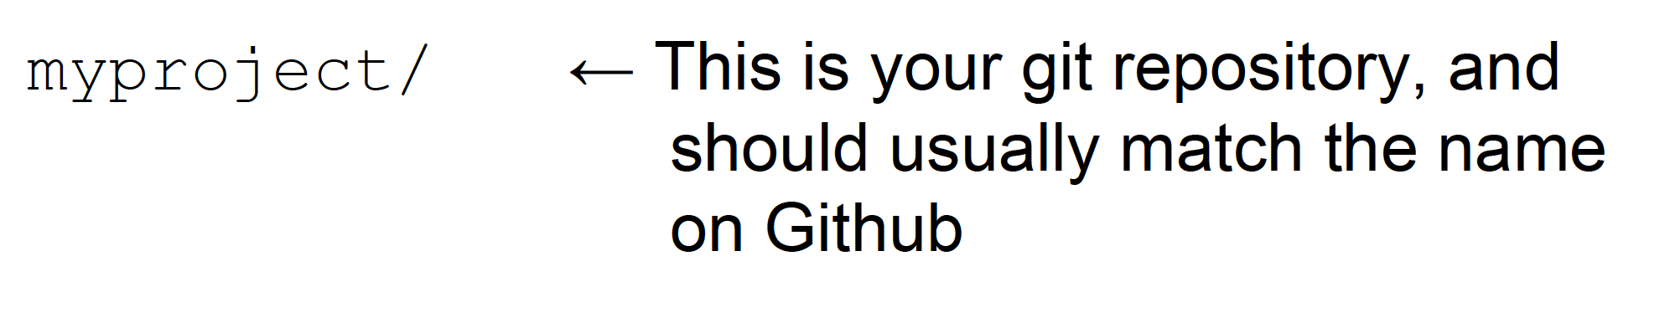
Python packages

Slide 22
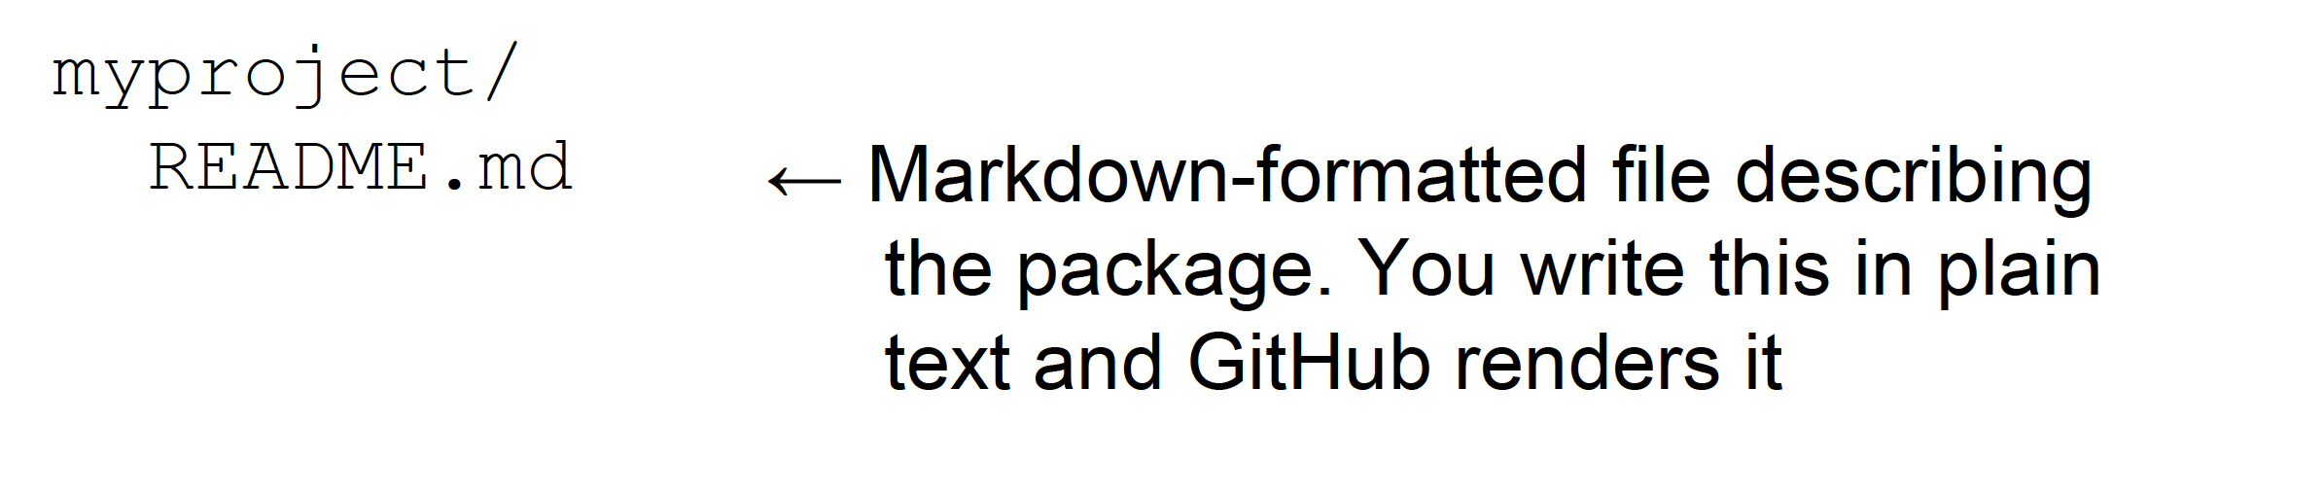
Python packages

Slide 23
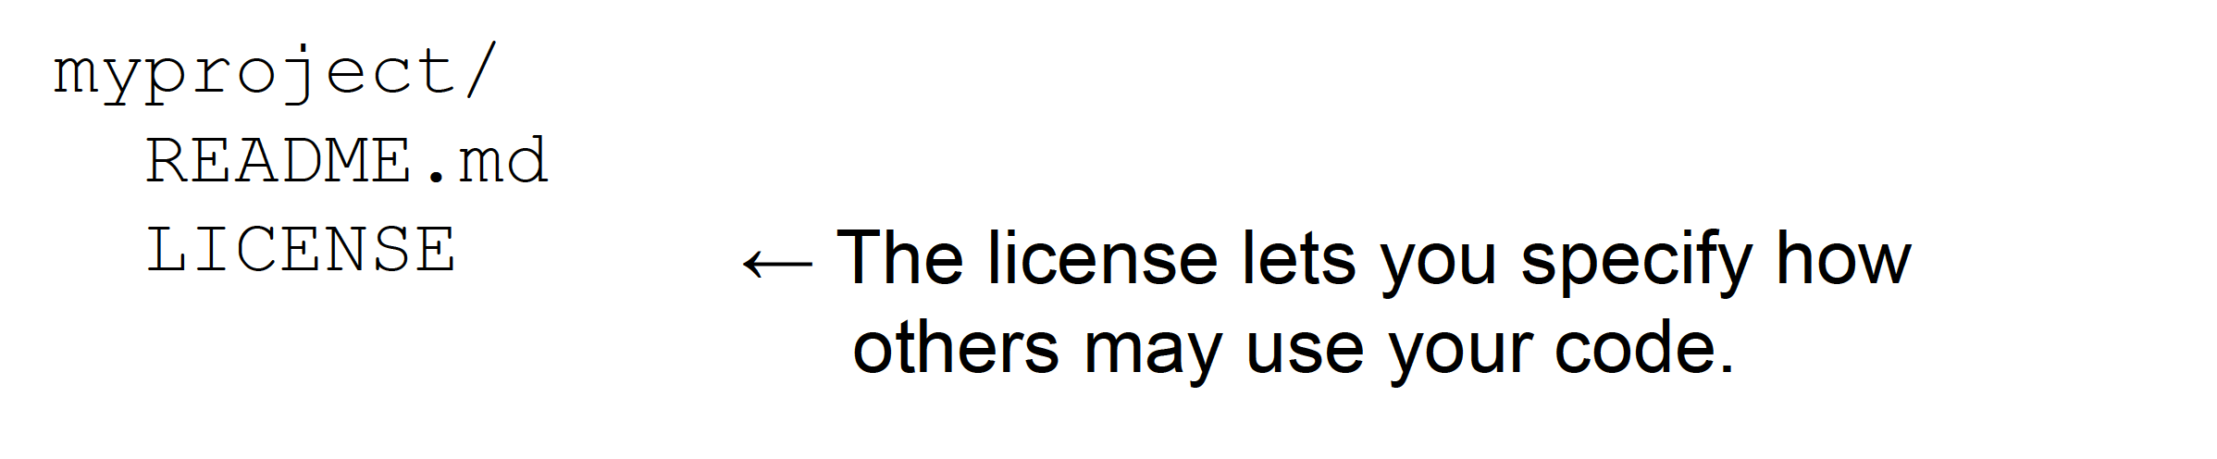
Python packages
http://www.astrobetter.com/blog/2014/03/10/the-whys-andhows-of-licensing-scientific-code/

Slide 24
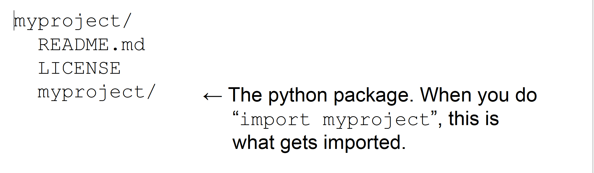
Python packages

Slide 25
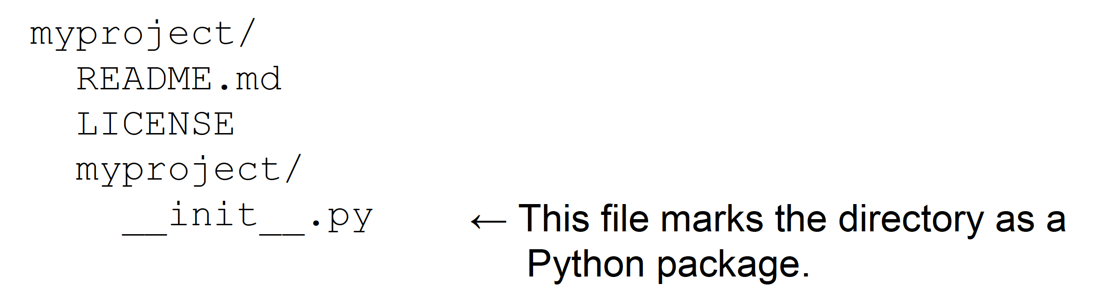
Python packages

Slide 26
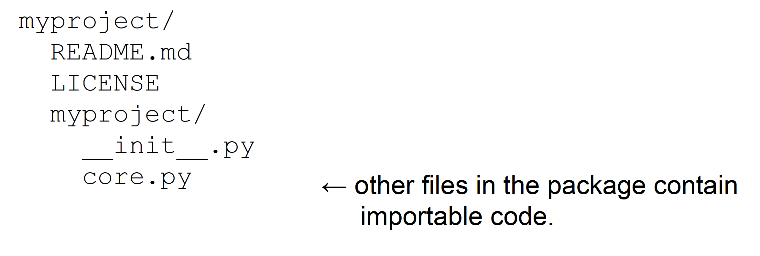
Python packages

Slide 27
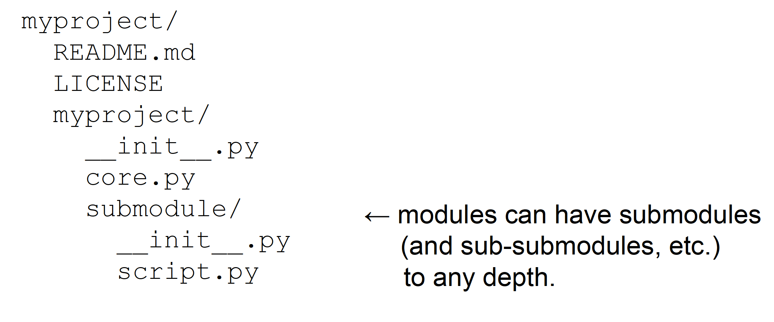
Python packages

Slide 28
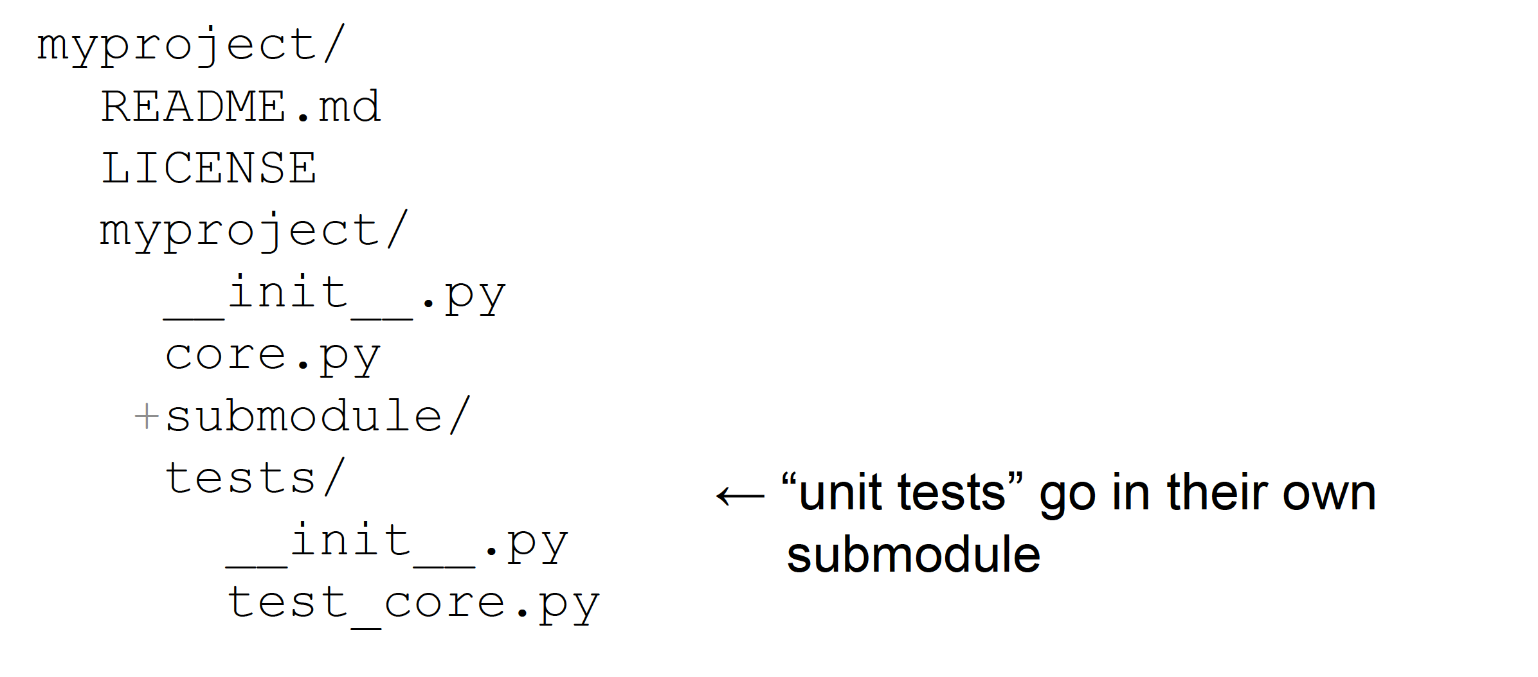
Python packages

Slide 29
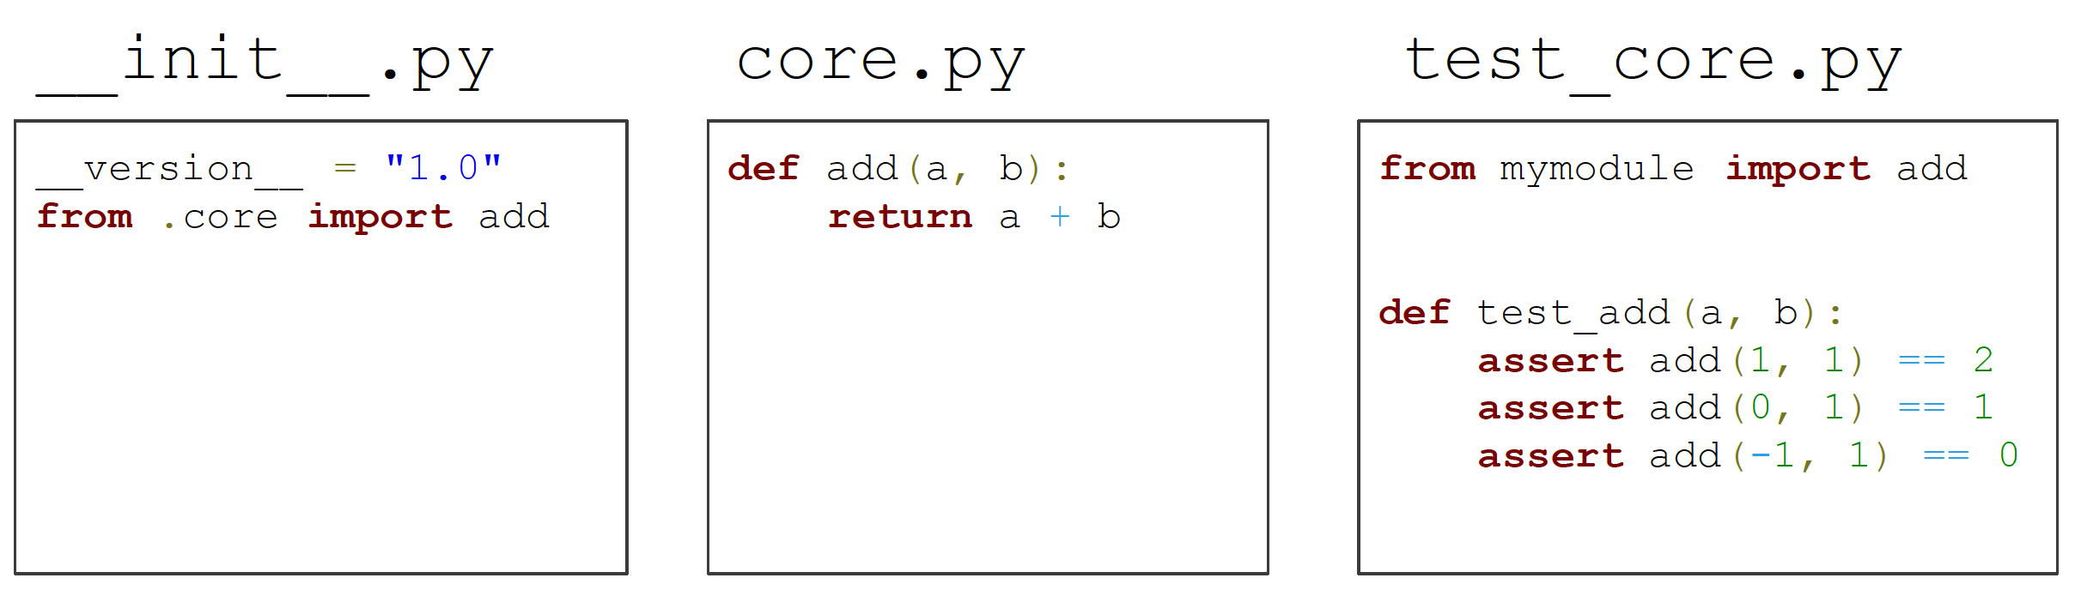
Python packages
Run the tests with
pytest mymodule
coverage run –m unittest discover

Slide 30
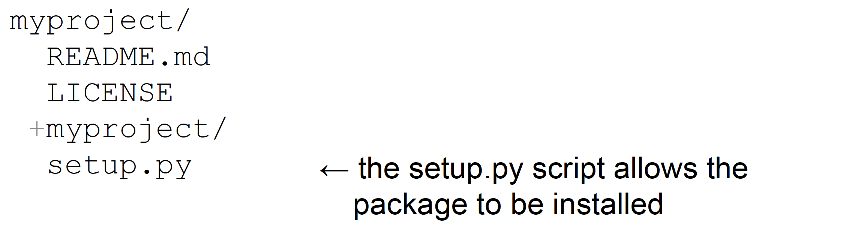
Python packages
setup.py examples & help:
https://github.com/pypa/sampleproject/
https://github.com/uwescience/shablona

Slide 31
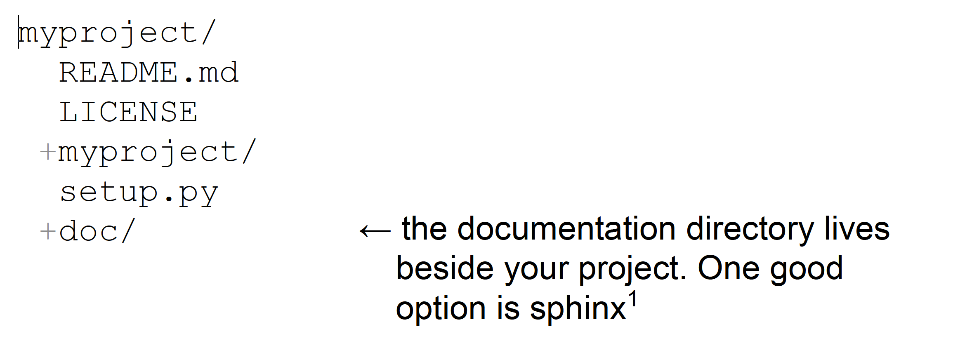
Python packages
www.sphinx-doc.org
Also where use cases, specs, presentations, posters, etc. go.

Slide 32
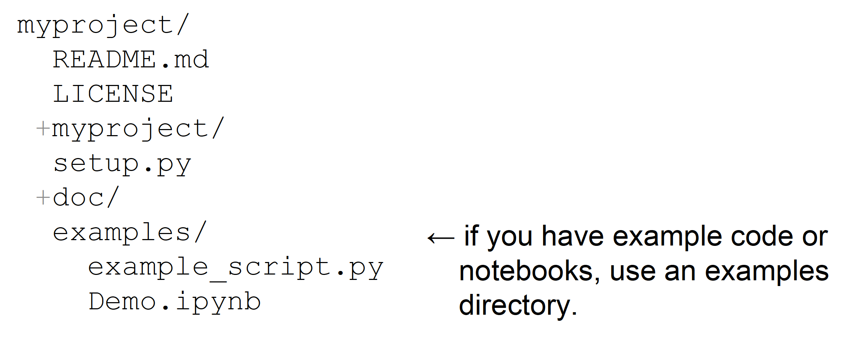
Python packages

Slide 33
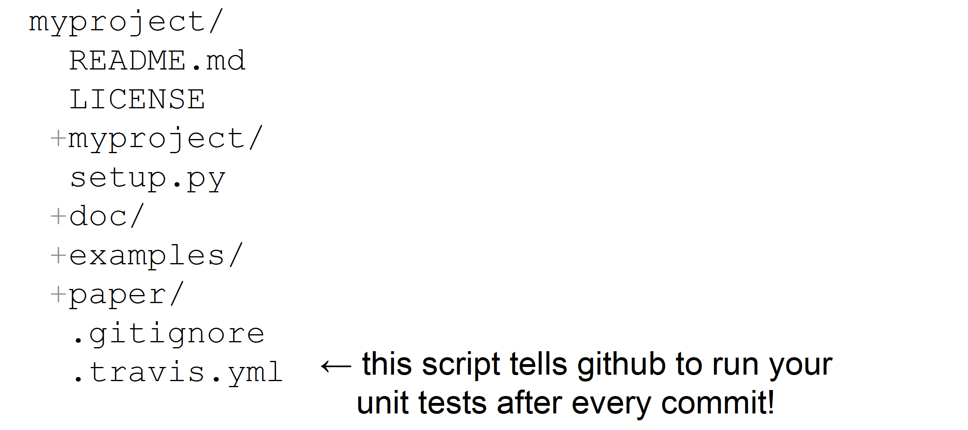
Python packages

Slide 34
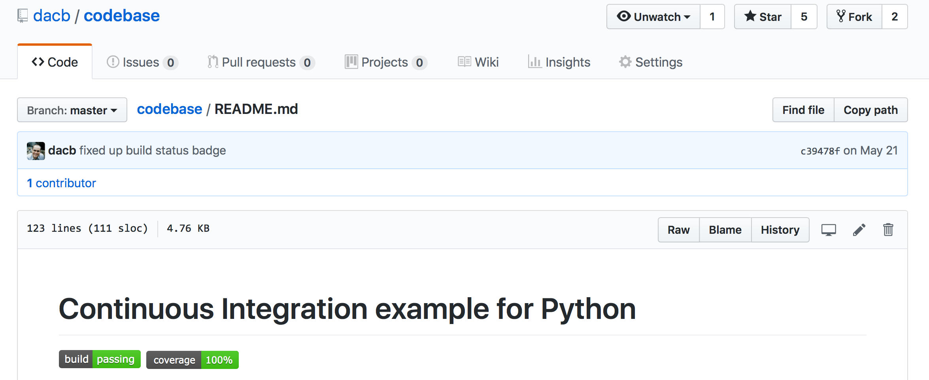
Continuous integration

Slide 35
Continuous integration
What is continuous integration?
CI
Automatically runs “stuff” after a push
Test for PEP8 compliance
Run unit tests
Evaluate test coverage
Render documentation
…
Let’s build setup an example repo
Start by forking this:
https://github.com/UWSEDS/codebase

Slide 36
Continuous integration
Other CI examples
The complete codebase example
https://github.com/dacb/codebase
The uber example shablona
https://github.com/uwescience/shablona
An example of CI using conda managed virtual environments
https://github.com/BeckResearchLab/ECSOpenData

Slide 37
Continuous integration
Let’s setup CI for a repo
If there is time, we’ll do coverage too!

Slide 38
Homework
Finish making your project into a Python package with
README.md that describes the overview
Software license
A defined environment
Unit tests
A continuous integration framework**
A setup.py for PyPi (i.e. pip) installation
See Shablona or PyPi docs
An autodoc generation system**
See Shablona or PyPi docs
E.g. Sphinx
ReStructured Text
** optional but will be viewed positively during grading!

